Slide 1


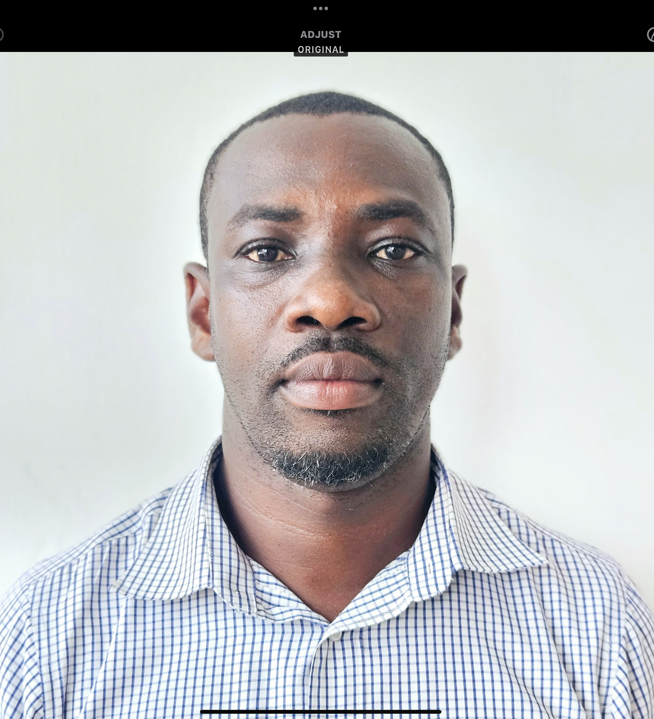
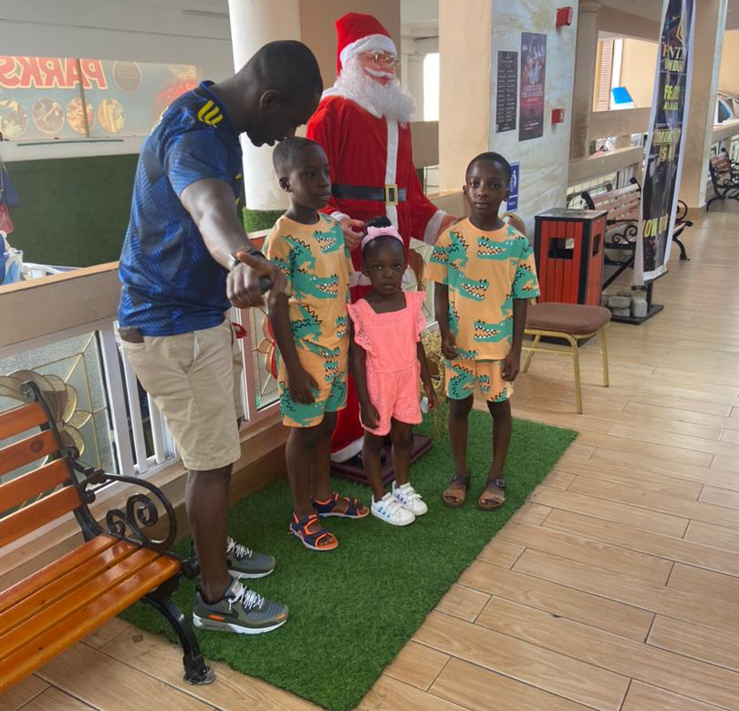
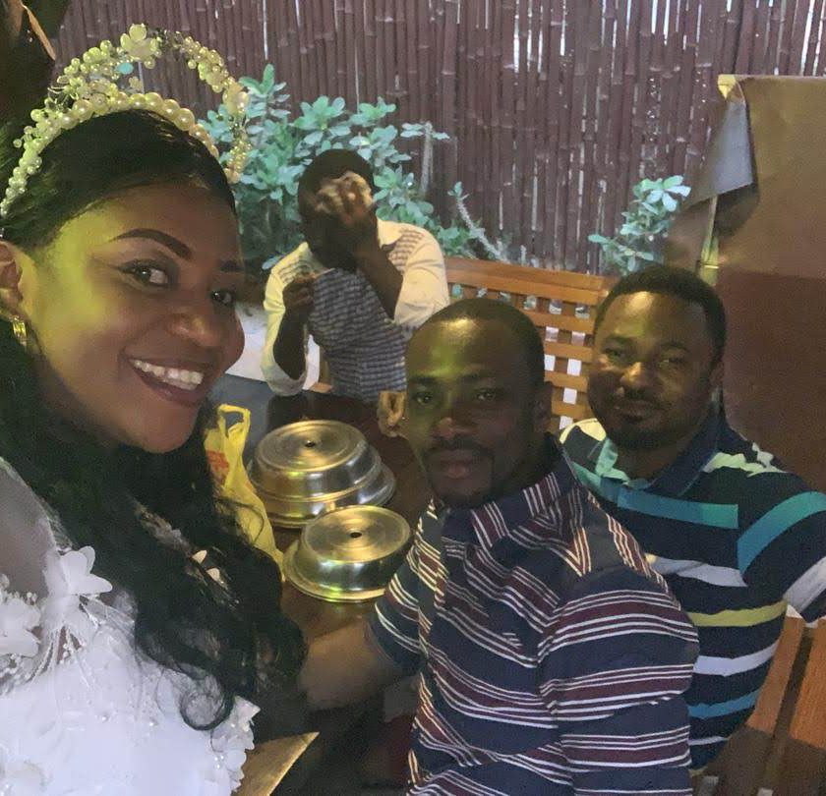
Getting to Know Me
Work
Personal
My role
Outbound Logistics Manager
Significant others / family members / furry friends in my life
A wife and 3 kids, 5 direct sibblings and 5 step sibblings
Tenure in ofi/Olam
Since June 1st 2009
How I enjoy spending my free time
I hang out with either my wife and kids, just myself or with friends
Previous companies I have worked at
Unique Star Foods Company Limited
My favorite / comfort food
Fufu and Palmnut soup with goat meat
Why I joined ofi/Olam and what keeps me here?
Career Growth, Culture and Values, and Reputation and Stability
My favorite song
(something Inside) So Strong by Kenny Rogers
Frederick Osei Antwi
Freddy’
I like pulling people legs
This is me outside work, doing stuff I enjoy in my life …

